Slide 1

Team Name :The Guardians
Team Leader Name : Aditya Suryawanshi
Problem Statement : Build an AI-powered solution that supports rural ecosystems, sustainability, or resource-efficient systems.

Slide 2

Brief about the Idea:
Title:
BHARAT-SETU: The Unified Rural Intelligence Platform: One Engine, Three Solutions. Powered by India’s DPI
The Problem: The Rural Data-to-Action Gap
Economic Loss: Farmers sit on valuable ecological assets (carbon credits) but cannot monetize them due to complex, expensive verification barriers.
Blind Planning: Governments lack real-time data to predict "Distress Migration," leading to reactionary aid rather than proactive prevention.
2. The Solution: Our platform breaks this cycle by unifying three powerful tools into one seamless engine:
A. Carbon-Kosh (The Economic Engine):
What it does: Uses Satellite AI to auto-verify Soil Organic Carbon (SOC) remotely.
The Outcome: It converts this green cover into Carbon Credits, providing farmers with a verified, secondary income stream (₹3,000–₹11,000 per ton) without requiring them to install expensive sensors.
B. Gram-Twin (The Ecological Planner):
What it does: Generates a "Digital Twin" (3D Map) of the village using geospatial data.
The Outcome: Enables Sarpanches to visualize degradation hotspots and plan scientific restoration projects (MGNREGA/ now Viksit Bharat-G RAM).
C. Migration Shield (The Social Guardian):
What it does: This predictive layer analyzes the financial data (Carbon Income + Crop Yields) and climate risk data to identify families at risk of economic collapse.
The Outcome: Alerts District Magistrates 3 months in advance of a potential exodus, acting as an "Early Warning System" for distress migration, allowing for timely government intervention.

Slide 3
How is it different from existing ideas?
1. How is it different from existing ideas?
Existing Agri-Tech solutions are fragmented as single purpose apps offering either weather alerts, or loan access, or market linkage.
Our Solution(Bharat-Setu) is the first platform to integrate ecology (Carbon-Kosh), infrastructure (Gram-Twin), and social stability (Migration Shield) into a single feedback loop.
From "Yield-Centric" to "Value-Centric":
Most competitors focus only on increasing crop yield (which is risky and weather-dependent).
We focus on increasing asset value (paying farmers for soil health), creating a risk-free guaranteed income stream that existing solutions ignore.
Zero-Hardware Verification:
Current carbon credit solutions rely on manual field visits or expensive IoT sensors.
Our solution relies 100% on Remote Sensing AI (Sentinel-2), eliminating hardware costs entirely to make carbon credits accessible to small farmers.
2. How will it be able to solve the problem?
Solving Economic Instability: By formalizing Carbon Credits for smallholders(1-2 acres) via Carbon-Kosh, we create a "financial buffer." Even if a crop fails, the carbon income (verified by Bedrock) remains stable, preventing the immediate cash loss that forces migration.
Scientific Resource Allocation: Instead of guessing where to build infrastructure, Gram-Twin uses satellite data to pinpoint exactly where water conservation structures are needed. This ensures Viksit Bharat G-RAM funds are spent on scientifically validated projects, solving the Ecological Crisis.
Proactive Governance: Governments currently lack granular data on distressed families. Migration Shield uses Amazon Q to analyse financial data (Carbon + Yield) and generate a precise "Risk Score." This acts as an "Early Warning System," allowing officials to intervene before a family is forced to leave.

Slide 4
USP (Unique Selling Proposition):
Zero-Hardware Scalability (The Cost Benefit):
Unlike competitors requiring ₹50,000 IoT sensors per farm, our Hardware-Free Architecture uses free Sentinel-2 satellite data processed by Amazon
SageMaker. We can onboard 146 Million hectares of Indian farmland instantly at ₹0 hardware cost.
2. The "Double-Dip" Income Model (The Value Benefit):
We are the only platform that monetizes the same pixel of land twice:
Agricultural Yield (Food): The traditional crop income.
Carbon Sequestration (Credits): A verified secondary income generated by Bedrock Agents. Impact: This creates a 20-30% guaranteed income floor for
farmers, ensuring financial survival even if monsoons fail.
3. Sovereign AI Sovereignty (The Trust Benefit):
While others rely on Western models, our intelligence is built on Indian Digital Public Infrastructure (DPI), integrating Bhashini for language and
MapMyIndia for local context which ensures that data stays sovereign and locally relevant.
4. Self-Sustaining Model (The Business Benefit):
The system pays for itself. A small transaction fee on the carbon credits generated funds the AWS Cloud infrastructure, removing the dependency on eternal
government grants and ensuring long-term viability.

Slide 5
Feature List & Technical Vision:
Title: The Bharat-Setu Unified Ecosystem: One Engine, Three Solutions. Powered by India’s DPI.
1. Automated Carbon Quantification (Carbon-Kosh)
The Function: A "Zero-Touch" verification engine for Carbon Credits.
The Tech Stack:
Input: Sentinel-2 Satellite Imagery (Open Source).
Engine: Amazon SageMaker runs the NDVI analysis to measure green cover on small farms (1-2 acres).
Output: Auto-generates a text-based "Carbon Credit Certificate," eliminating the need for physical inspections.
2. Precision Ecological Planning (Gram-Twin)
The Function: A "Digital Twin" (3D Map) for Village Administration.
The Tech Stack:
Mapping Layer: MapMyIndia (Mappls) APIs for hyper-local Indian terrain data.
Analysis: Amazon Q aggregates this with farm data to identify "Degradation Hotspots" (high soil erosion areas).
Impact: Enables the Sarpanch to plan Viksit Bharat G-RAM projects exactly where the land needs healing.
3. Predictive Distress Monitoring (Migration Shield)
The Function: A proactive "Migration Early Warning System" (MEWS).
The Tech Stack:
Voice Interface: Bhashini (Bhashini-ASR/TTS) for accurate dialect support (Bhojpuri, Marathi, Tamil).
Intelligence: Amazon Bedrock acts as the "Reasoning Brain" behind Bhashini, translating the farmer's voice intent into database queries.
Impact: Triggers "Distress Alerts" 60-90 days before mass migration, allowing District Magistrates to intervene early.

Slide 6
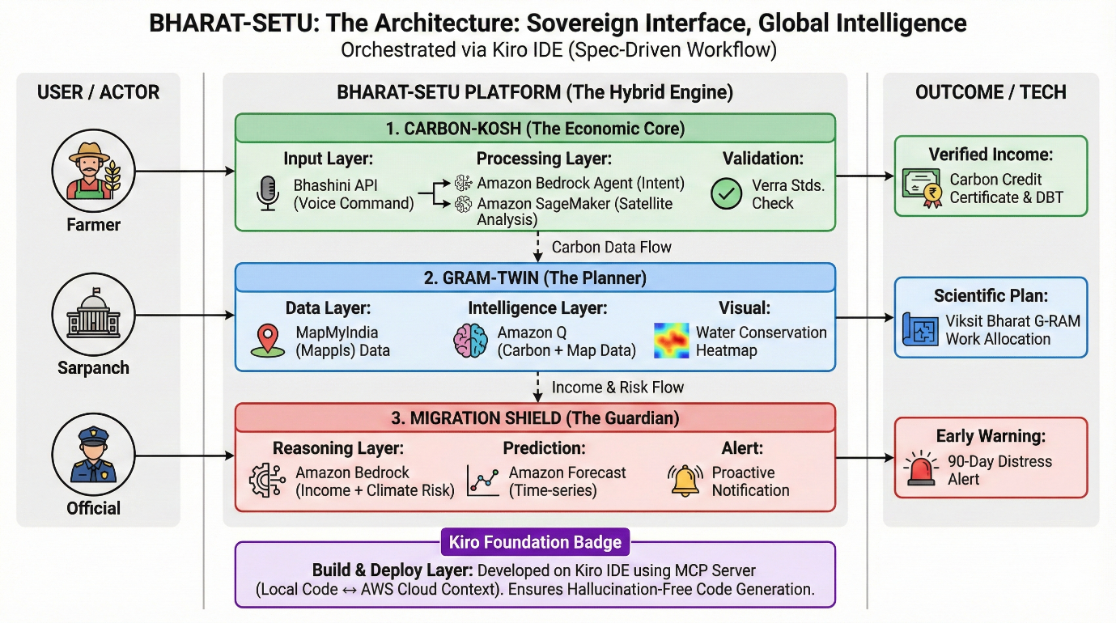
Use Case Diagram:

Slide 7
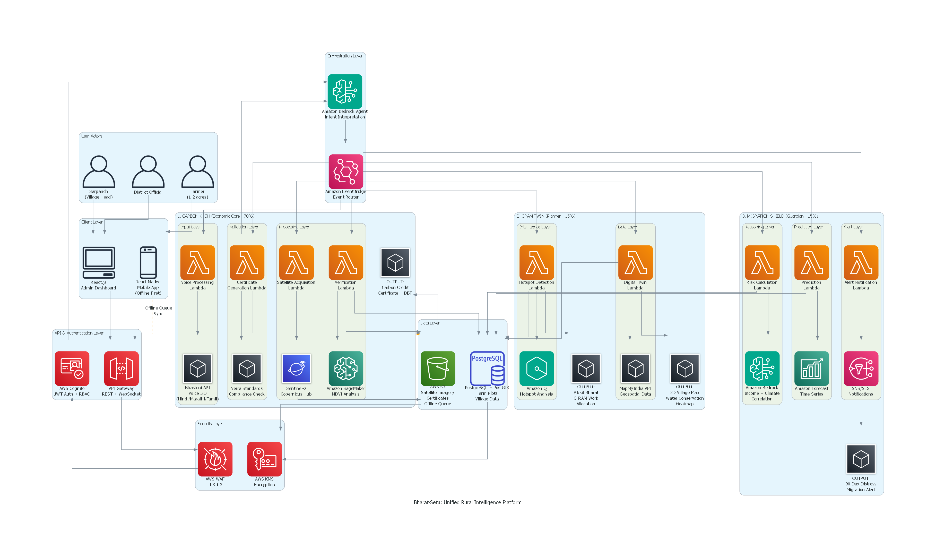
Architecture diagram of the proposed solution:

Slide 8
Technologies to be used in the solution:
The "Bharat-First" Tech Stack: Zero-License Cost, Open-Source, and DPI-Integrated.
1. Core Intelligence (The AI Engine):
Sentinel-2 (ESA) / Landsat-9: Sourcing free multispectral satellite imagery (Red/NIR bands).
AWS SageMaker: Training custom NDVI & Random Forest models on historical data.
Python (Rasterio & Geopandas): Processing geospatial raster data to calculate Green Cover density.
2. Cloud Infrastructure (The Backbone):
AWS Lambda (Serverless): Event-driven compute that runs code only when a user makes a request.
PostgreSQL + PostGIS: Storing complex village boundaries and farm polygons.
3. Digital Public Infrastructure (The Interface):
Bhashini API (MeitY): Real-time Speech-to-Text (ASR) in local dialects (Bhojpuri, Hindi, Tamil).
MapMyIndia (Mappls): Hyper-local visualization and geofencing.
React Native (Frontend): Mobile application framework.

Slide 9
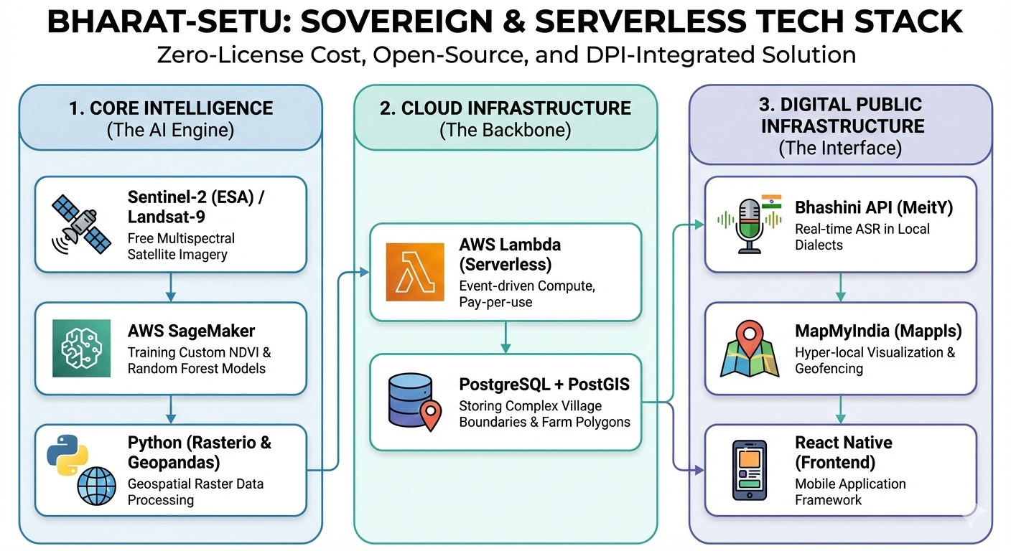
Technologies to be used in the solution:

Slide 10
Estimated implementation cost (optional):
Category | Component | Scale / Usage | Cost Type | Est. Cost (INR)
Generative AI | Amazon Bedrock (Claude 3.5 Sonnet) | 5M Tokens (Voice Queries) | Monthly OpEx | ₹1,500
Compute Core | AWS Lambda (Serverless) | 100k Events (On-Demand) | Monthly OpEx | ₹200
Satellite AI | SageMaker Inference (Spot Instances) | Batch Processing (Weekly) | Monthly OpEx | ₹1,600
Data & Maps | RDS + S3 + MapMyIndia | Village Data & Maps | Monthly OpEx | ₹1,400
Admin Dashboard | Amazon Q Business | 2 System Admins | Monthly OpEx | ₹500

Slide 11
Estimated implementation cost (optional):
Note: Operational Costs for a Pilot Cluster (50 Villages / ~5,000 Farmers)
Category | Component | Scale / Usage | Cost Type | Est. Cost (INR)
Indian DPI | Bhashini API (Voice) | Unlimited (Startup Tier) | Monthly OpEx | ₹0
TOTAL RUNNING COST | (Sustainability Factor) | To maintain 50 Villages | Monthly | ~ ₹5,200 / Month
AI INNOVATION | SageMaker Model Training | One-Time Deep Learning Setup | One-Time CapEx | ₹15,000

Slide 12


